Slide 1
Topics to be Covered
Graph Matching
Graph Colouring

Slide 2
Matching
Example: 4 applicants Anna, Bob, Catty and Don apply to five jobs J_{k}, 1 < k < 5. There qualifications are listed in the table below.
Applicant | Job
Anna (A) | J₂, J₅
Bob (B) | J₂, J₅
Catty (C) | J₁, J₃, J₄, J₅
Don (D) | J₂, J₅

Slide 3
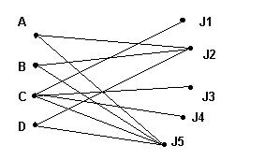
Example
The edges represent qualification for a job.
A matching consists of finding jobs for qualified persons

Slide 4
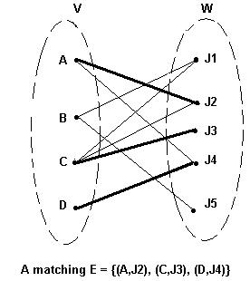
Definition of matching
Let G be a directed, bipartite graph with disjoint vertices V and W in which the edges are directed from V to W
A matching for G is a set of edges with no vertices in common.

Slide 5
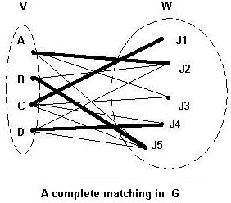
Maximal and complete matching
A maximal matching for G is a matching E which contains the maximum number of edges
A complete matching for G is a matching E with the property that for every v ∈ V, then (v,w) ∈ E for some w ∈ W.

Slide 6
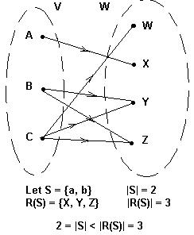
Hall's marriage theorem
Let G be a directed, bipartite graph with disjoint sets of vertices V and W and with directed edges from V to W.
Let S ⊆ V.
Let R(S) = {w ∈ W | v ∈ S and (v, w) is an edge in G}
Then: there exists a complete matching in G if and only if
|S| < |R(S)| for all S ⊆ V.

Slide 7
Graph Coloring
Problems related to coloring of maps of regions, such as maps of parts of the world, have generated many problems in graph theory.
Consider the number of colours to ensure that no two adjacent regions have the same color...
Maps may be represented as graphs (dual graphs)

Slide 8
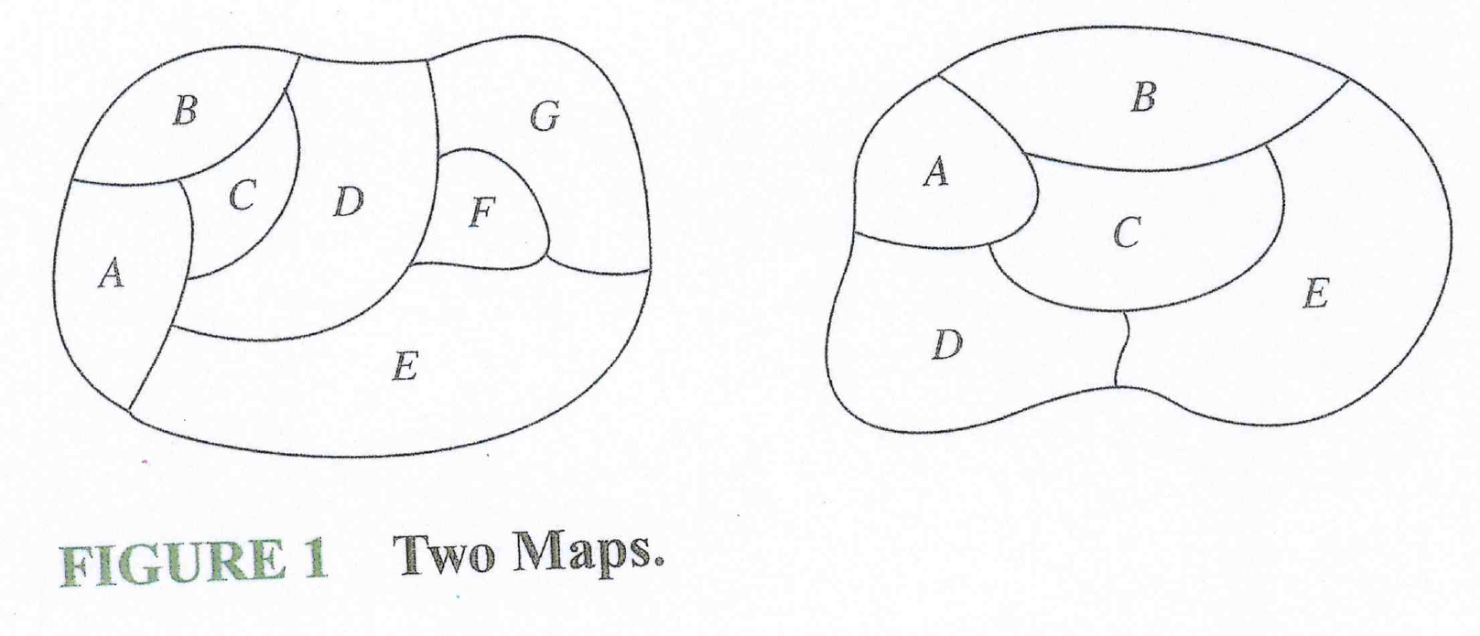
Graph Coloring
Given the following maps...

Slide 9
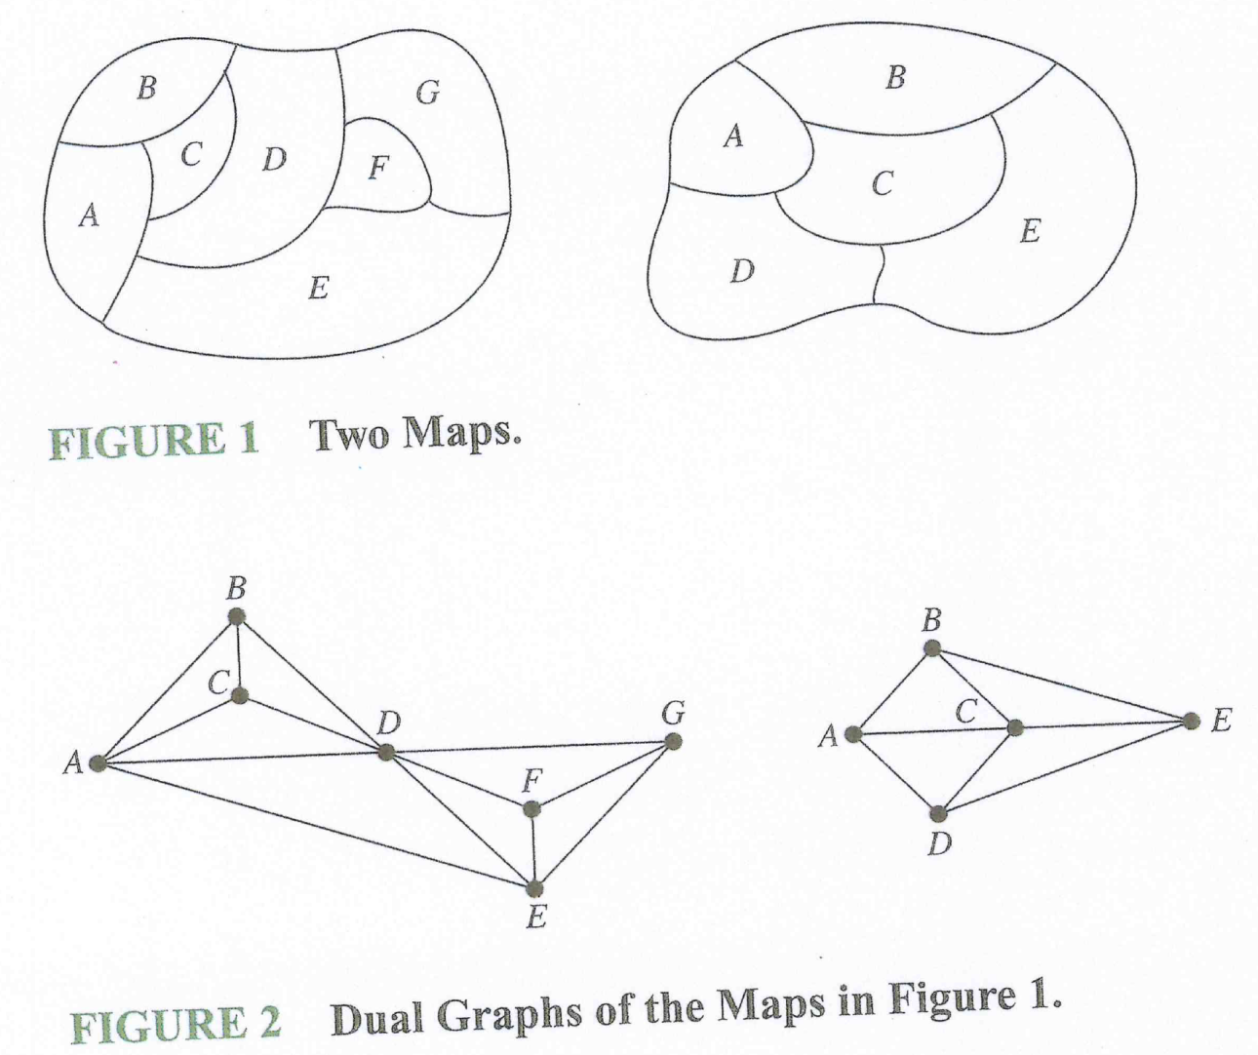
Graph Coloring
Figure 2 displays the dual graphs that corresponds to the maps in Figure 1.

Slide 10
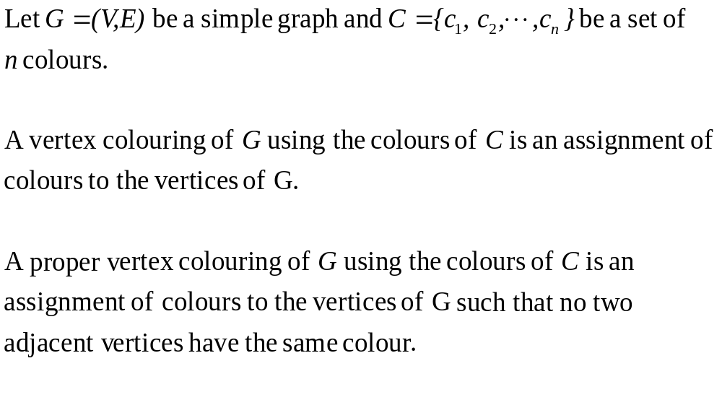
Graph Coloring

Slide 11
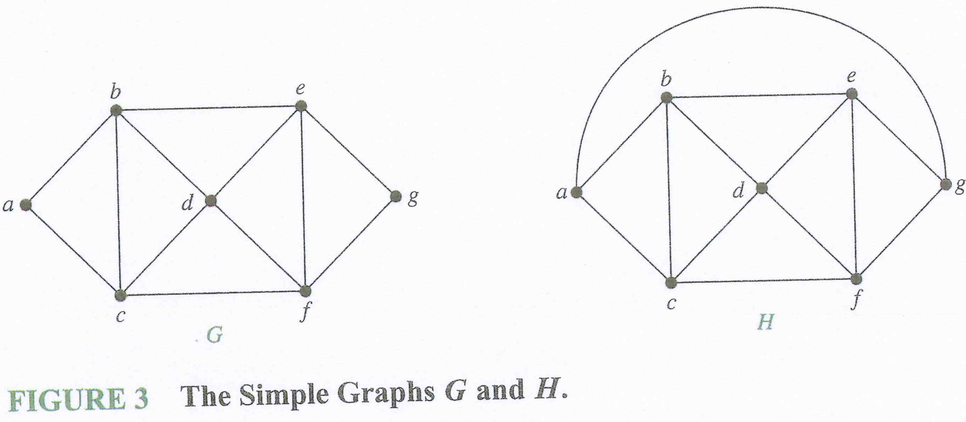
Graph Coloring
Consider Graphs G and H below

Slide 12
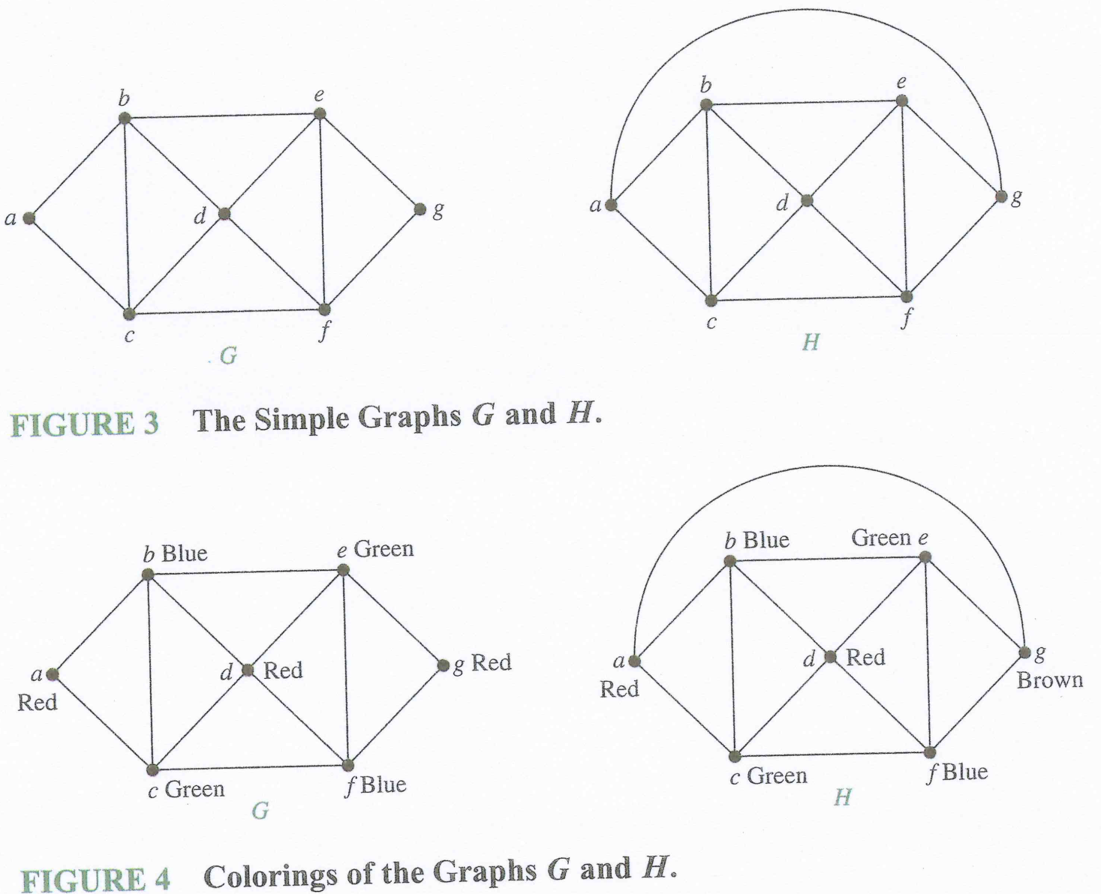
Graph Coloring
Figure 4 displays the coloring of Figure 3.

Slide 13
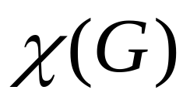
Chromatic Number
The smallest number of colours needed to make a proper vertex colouring of a simple graph G is called the chromatic number of G. The chromatic number of G is denoted by

Slide 14

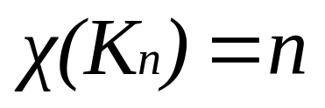
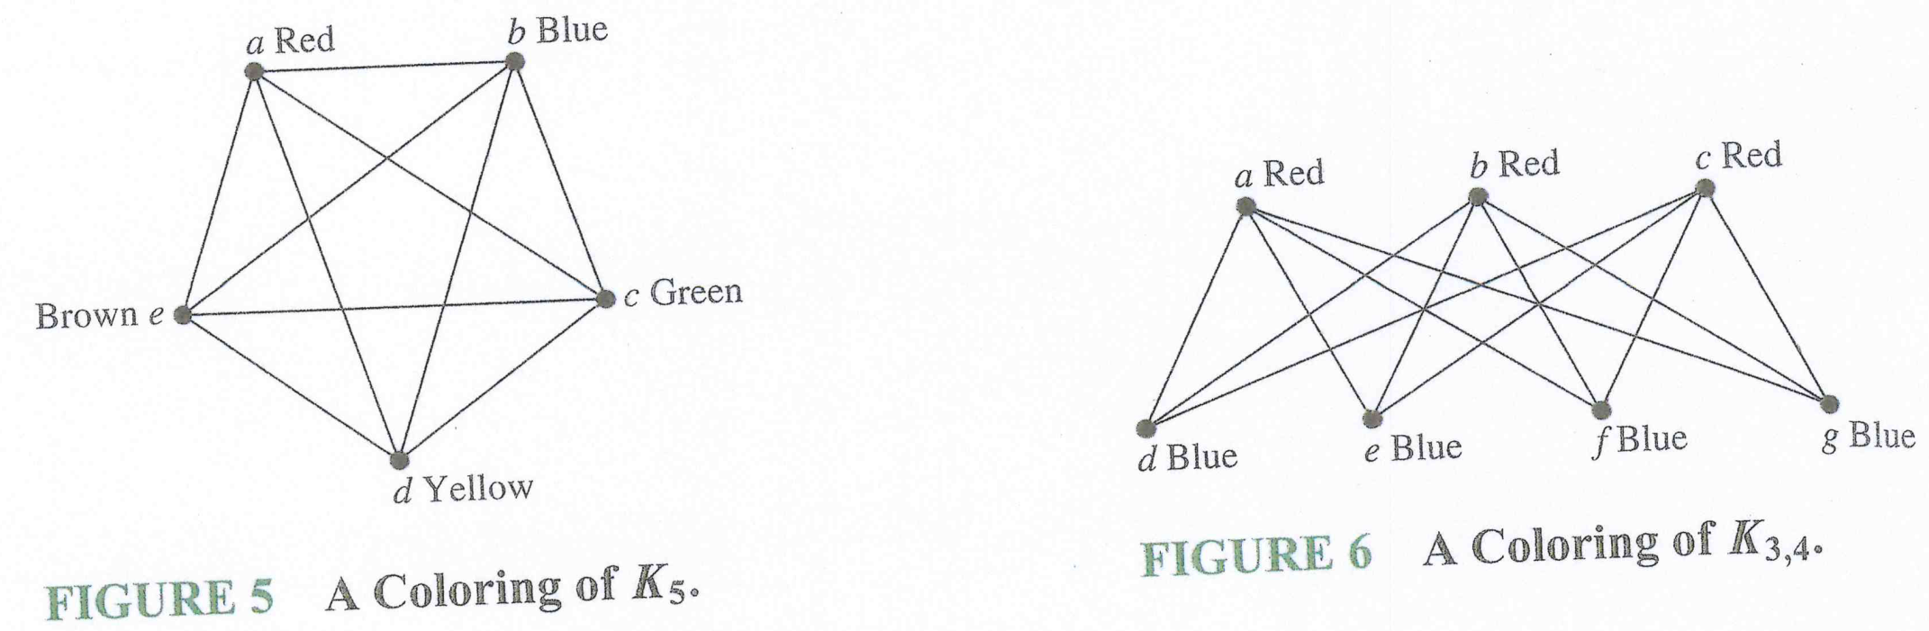
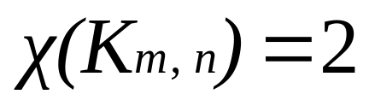
Graph Coloring
Consider the complete graphs K₅ and K_{3,4}. What is the chromatic number, of each?

Slide 15
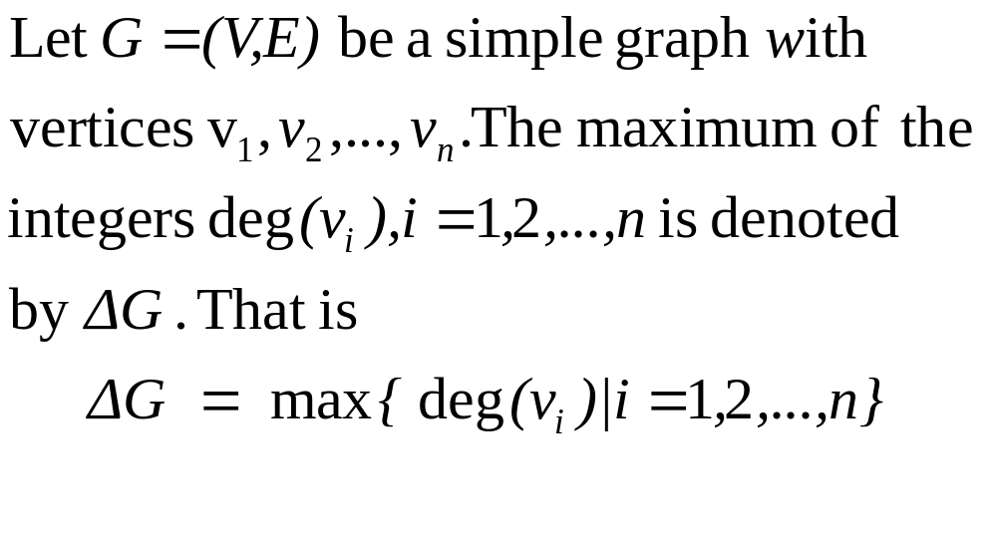
Definition

Slide 16
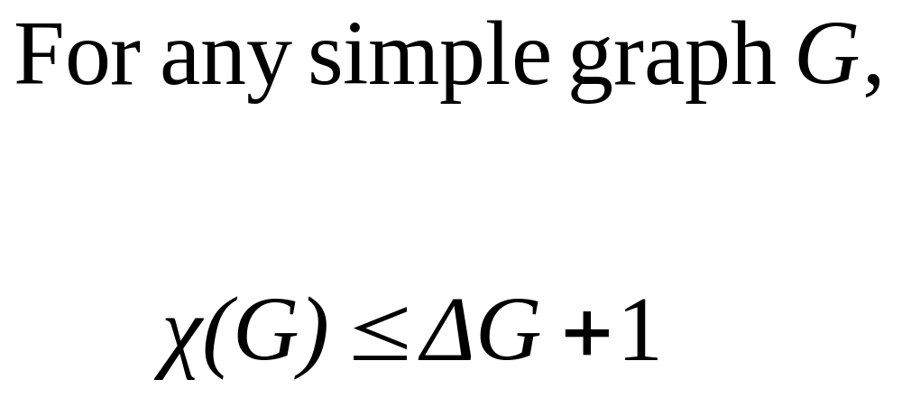
Theorem

Slide 17
Topics Covered
Graph Matching
Graph Colouring

